Slide 1
King County House Pricing
Real Estate Development Recommendations
By: John Bruemmer
Nazar Mohl
Woojin Jun

Slide 2
Agenda
01
Stakeholder and Business Problem
02
Data Overview
03
Regression Analysis
04
Recommendations
05
Next Steps

Slide 3

Stakeholder And Business Problem
Stakeholder: A midsized real estate developer in King County
Problem: Which factors of a home most influence price and by how much

Slide 4
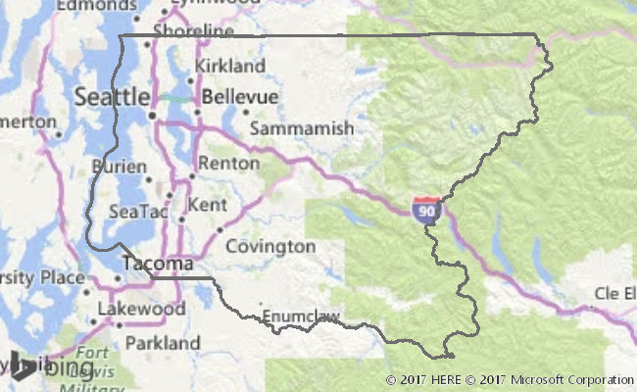
Available Data
King County House Sales dataset
21597 samples
2014 - 2015
Income and Population for Each Zip Code
https://www.point2homes.com/US/Neighborhood/WA/King-County-Demographics.html#MedianIncomeByZipcode
Notes:
Unused data columns: `id`, `date`, `sqft_lot`, `floors`, `waterfront`, `view`, `condition`, `grade`, `sqft_above`, `sqft_basement`, `yr_built`, `yr_renovated`, `lat`, `sqft_living15`, `sqft_lot15`

Slide 5
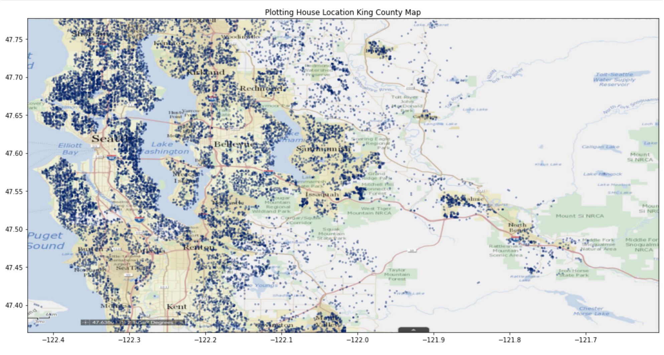
Notes:
Unused data columns: `id`, `date`, `sqft_lot`, `floors`, `waterfront`, `view`, `condition`, `grade`, `sqft_above`, `sqft_basement`, `yr_built`, `yr_renovated`, `lat`, `sqft_living15`, `sqft_lot15`

Slide 6
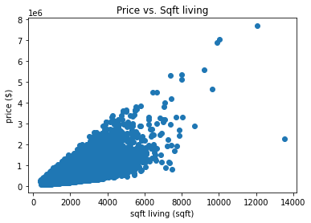
Price vs. Sq Ft Living Space

Slide 7
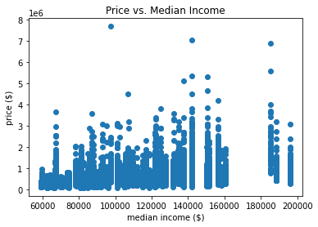
Price vs. Median Income of Zip Code
Using Median income as proxy for neighborhood desirability.
$1 increase in median income = price increase $3.34.
Notes:
Standard deviation is non constant. Not a perfect indicator but is useful for our analysis

Slide 8
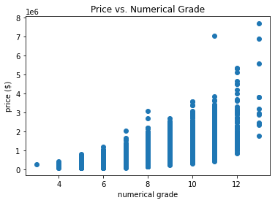
Price vs. Overall Grade of House

Slide 9
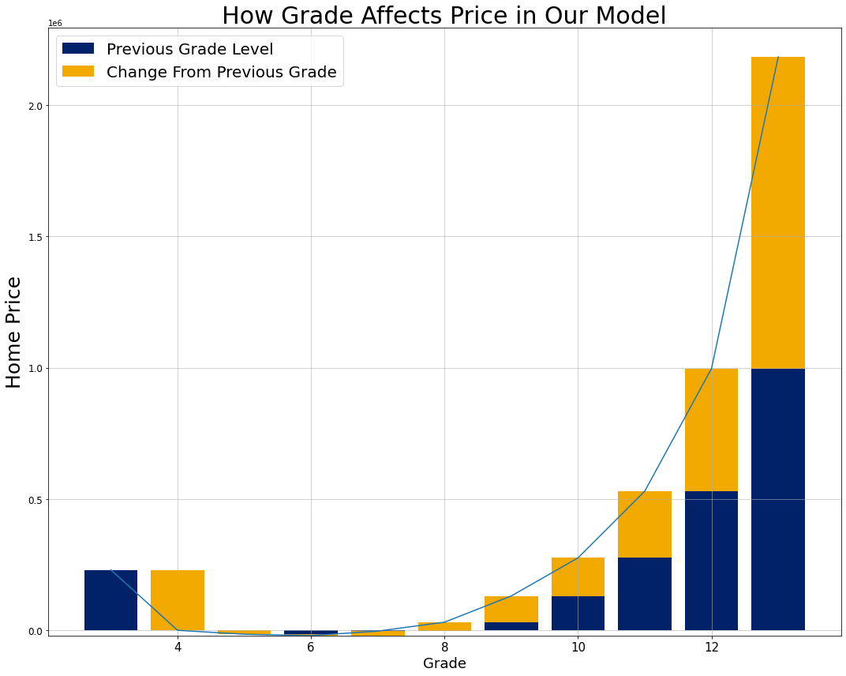
Effect of Grade on House Price
Notes:
Acknowledge the limitations of the model here. Explain in laymen’s terms why the extremes become less reliable. Find where model goes over or under specifically.

Slide 10
Effect of Grade on House Price
Increase in price across grades is exponential
Moving up lower grades does not incur much benefit.
If increase in costs across grades is linear, then focus on upper grades.
Notes:
Price of a home does not move up much from 5-8 but almost doubles going from 12-13.
Do not focus on upgrading across the lower grades because it will not greatly affect the price so the costs incurred may be higher than the benefit.
That being said spending money to move from 10-11 is very likely to be money well spent. The best way to take advantage of the exponential curve is to not focus on improving middling house grade but to spend resources moving up grades at the higher end.

Slide 11
Regression Results
Base Model
Model 1
Model 2
Final Model
Features: Living Square Feet
New Features : Median Income, Numeric Grade
New Features : View, Waterfront
New Features: Categorical Grade
Explained Variance : 0.45
Explained Variance : 0.6
Explained Variance : 0.63
Explained Variance : 0.70
Model Most Effective Between: $450,000 - $1.2 Million

Slide 12
Recommendations
Build homes with average or exceptional grades
Use locational data to prioritize underpriced homes in good locations

Slide 13
Next Steps
Gather More Data
Cost Analysis
Location Data
Other Home Features
Building Grade
School Districts
Neighborhood Features

Slide 14
Q&A
Thank You
John Bruemmer:
https://github.com/Jbruemmer
http://www.linkedin.com/in/john-bruemmer
Johnnybruemmer@gmail.com
Woojin Jun:
https://github.com/WoojinJun
https://www.linkedin.com/in/woojin-jun-6029bb114/
woojinjun93@gmail.com
Nazar Mohl:
https://github.com/NazarMohl
https://www.linkedin.com/in/nazar-mohl/
nazar.mohl@gmail.com

